Slide 1

Web-Scraping Project: Analyzing Half Year of Reuters News Articles For NYC Data Science Academy Joe Lu, Jan 2020

Slide 2
Areas to examine:
Which topics have been hot?
Application for reporters and article writers
Can we classify articles better?
Application for recommending articles
Can we measure the sentiment of articles?
Application for NLP and for finance

Slide 3
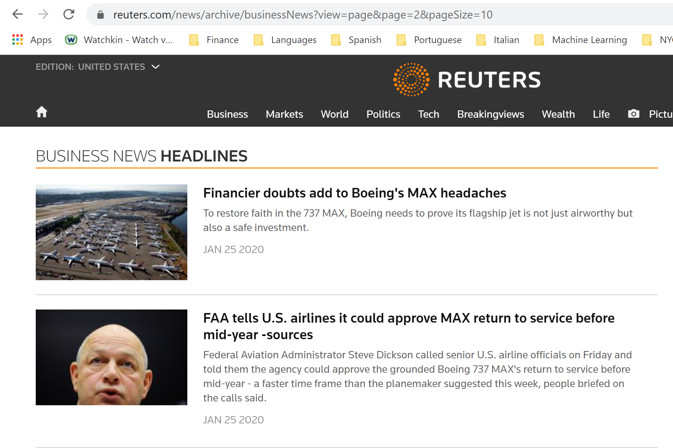

Slide 4


Data Source
6,500+ Reuters business articles over the past half-year (dates: July 25, 2019 to Jan 25, 2019)
For each article:
Timestamp (date + time)
Classification (world, technology, politics, etc)
Title
Full body of article

Slide 5
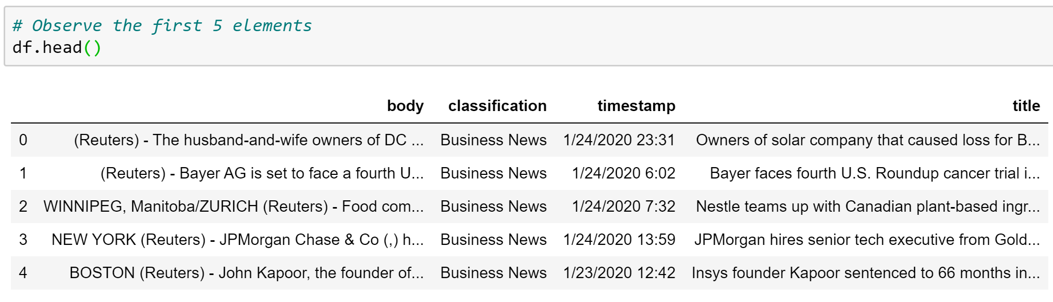

In Jupyter Notebook

Slide 6
First Glance
How many unique words do you think appeared in these 6,500+ news articles?
Given the dataset was from past 6 months, which were the most common words?

Slide 7
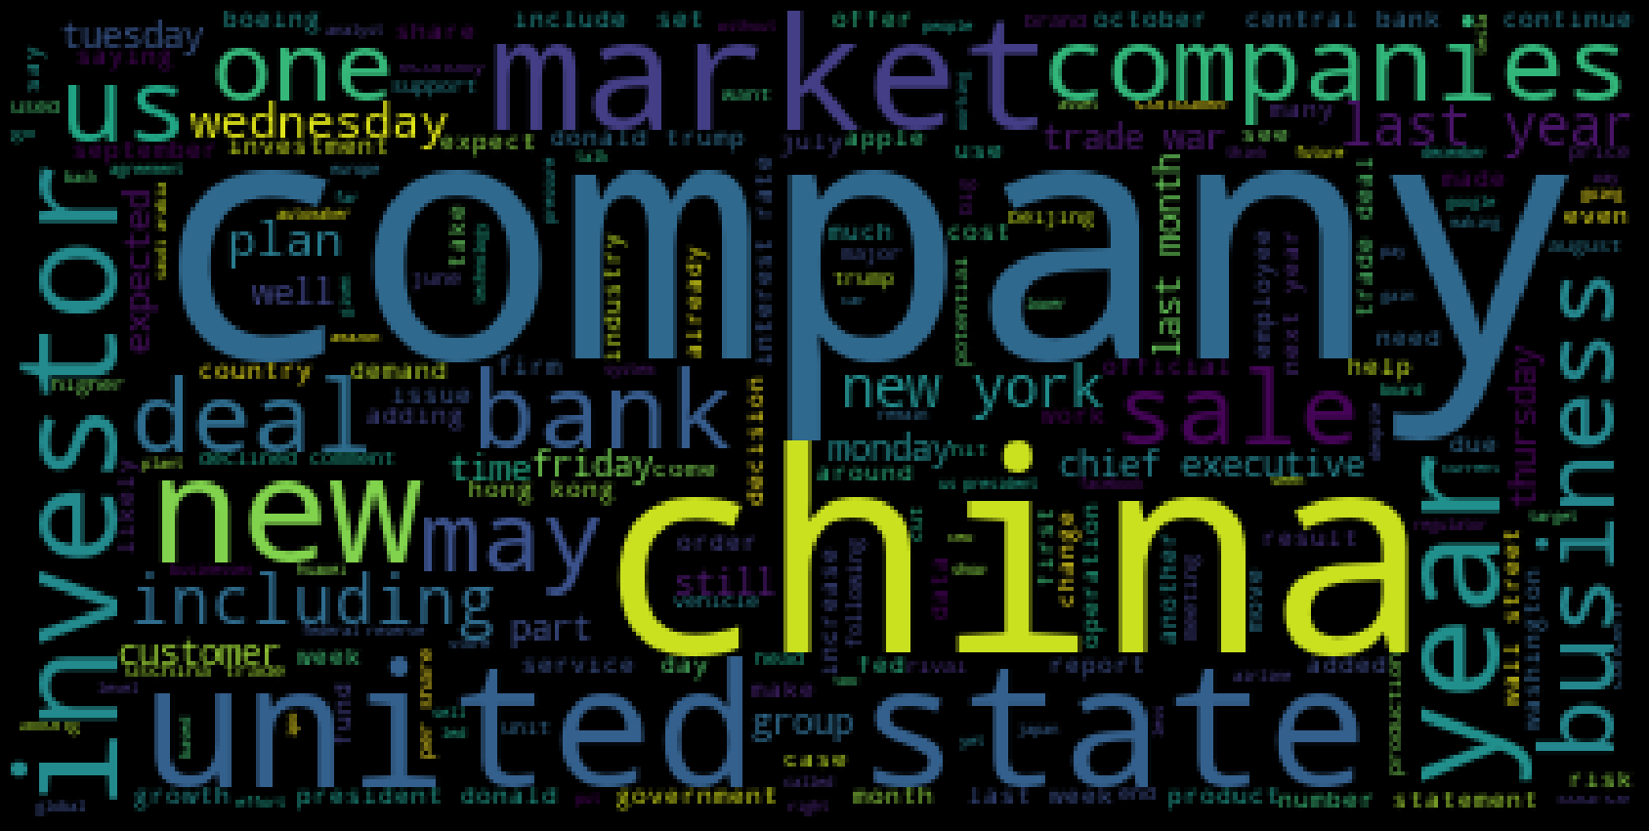
Using Python's “WordCloud” Package
Unique words: 54,000

Slide 8
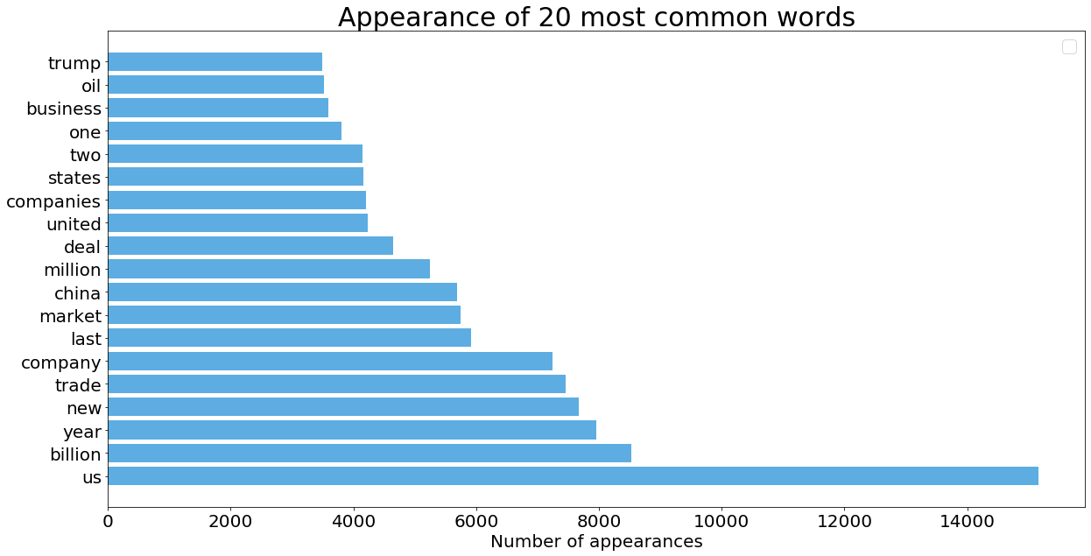

Slide 9
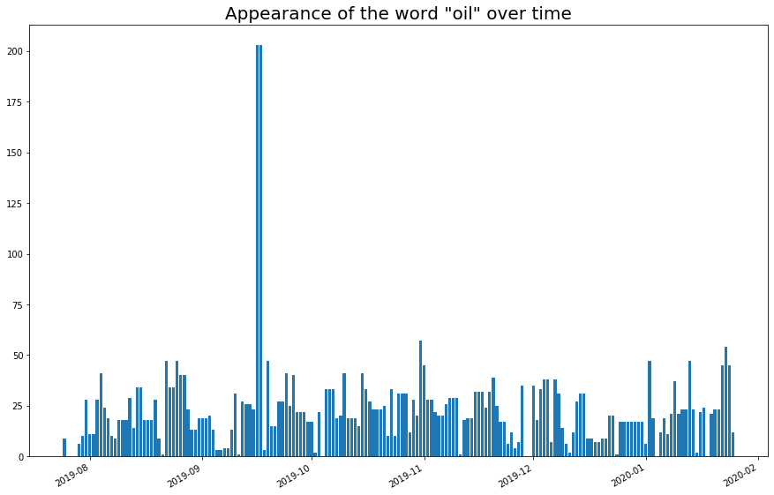
Sep 17, 2019: Two major Saudi oil installations hit by drone strike

Slide 10
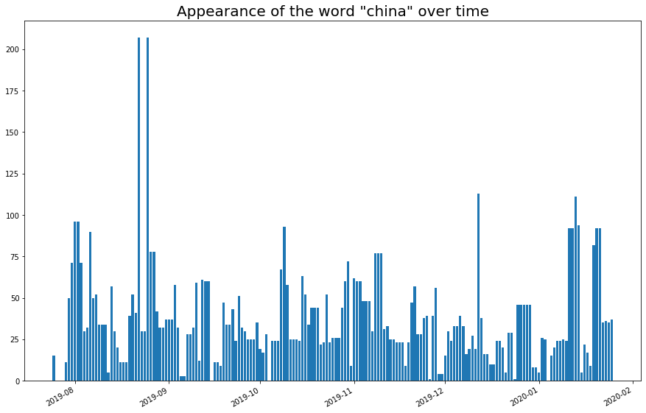
Aug 25, 2019: President Trump “regrets not raising tariffs higher on China”

Slide 11
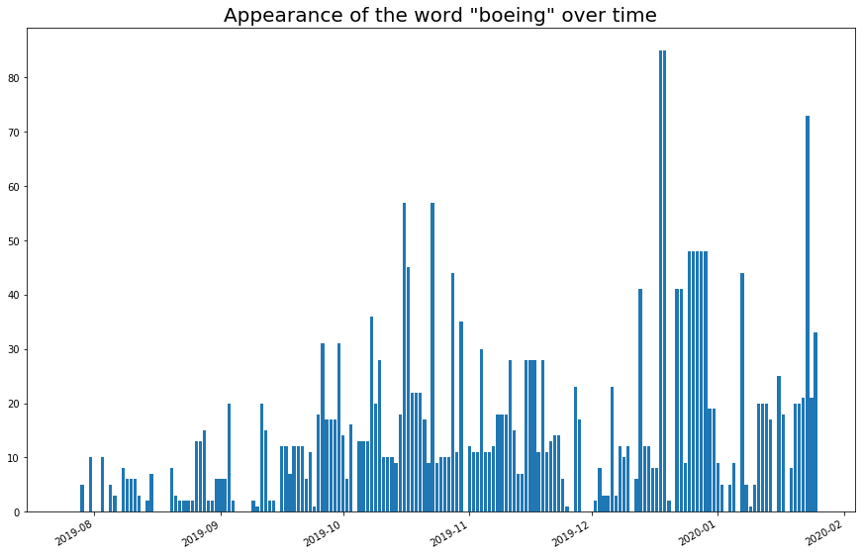
Mid Dec 2019: Boeing halts 737 Max production

Slide 12
Reuters already labeled the articles…
'Business News'
'Technology News'
'Big Story 15'
'Japan'
'World News'
'Foreign Exchange Analysis'
'Cyber Risk'
'Sustainable Business'
'Environment'
'Fintech'
11. 'Wealth'
12. 'Entertainment News'
13. 'U.S.'
14. 'Politics'
15. 'Deals'
16. 'Supreme Court'
17. 'U.S. Legal News'
18. 'Brexit'
19. 'Asia'
20. 'Hedge Funds - Asia'
21. 'Top News'

Slide 13

Some labels are redundant
“Big Story 15” and “Top News?”
“Supreme Court” and “U.S. Legal News?”
“Japan”, “Asia”, and
“Hedge Funds – Asia?”
There is a “Foreign Exchange
Analysis” category, but no
category for the stock,
fixed income, or commodity
markets?

Slide 14
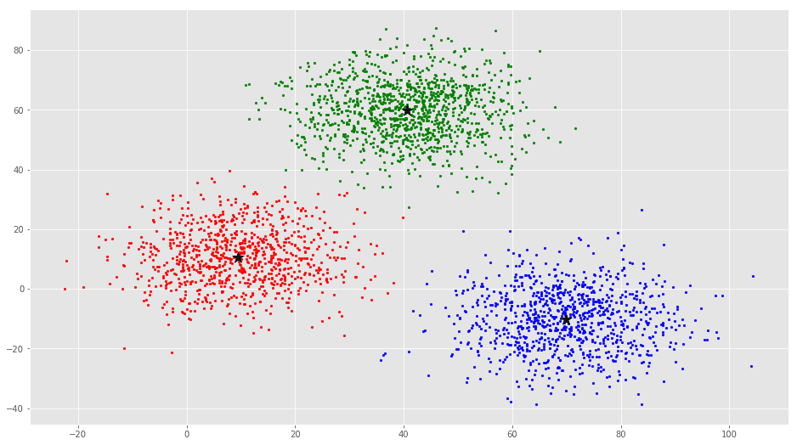
Let's use clustering to make new labels

Slide 15
Tell K-Means to find 10 categories
Category 1:
“737”: 163 times
“boeing”: 162
“max”: 157
Ex: “Boeing's 777X jetliner successfully completes…”
Ex: “Boeing's new CEO orders rethink on key jetline…”
Ex: “Airbus hits record highs…”

Slide 16
Tell K-Means to find 10 categories
Category 2:
“oil”: 147 times
“saudi”: 42
“crude”: 31
“opec”: 25
Ex: “Oil slides 2% as glut forecast…”
Ex: “Oil edges up after five days of losses…”
Ex: “Divergent paths: Oil, natural gas going different…”

Slide 17
Tell K-Means to find 10 categories
Category 3:
“billion”: 126 times
“ceo”: 110
“sources”: 95
Ex: “Nestle teams up with Canadian plant-based ingredients…”
Ex: “Xerox nominates new HP board after buyout…”
Ex: “JPMorgan board raises CEO Dimon's pay to….”

Slide 18
Tell K-Means to find 10 categories
Category 4:
“trade”: 248 times
“china”: 184
“deal”: 125
“trump”: 112
“tariffs”: 78
Ex: “Trump threatens big tariffs on car imports…”
Ex: “In U.S.-China Phase 1 trade deal…”

Slide 19
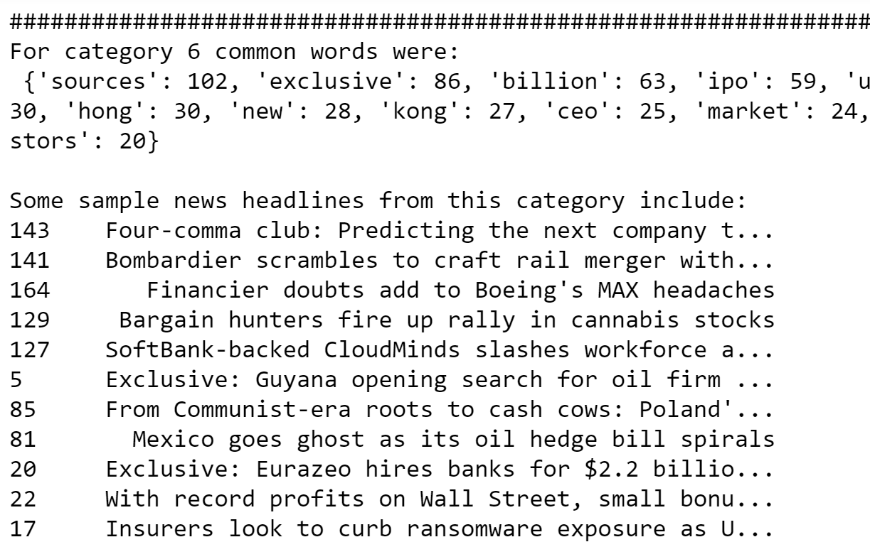
Tell K-Means to find 10 categories
Some other categories were less obvious

Slide 20
Sentiment Analysis
“NLTK” library can tokenize, show parse trees, evaluate sentiment, and more…
“SEATTLE (Reuters) - Boeing Co (,) on Saturday successfully completed the maiden flight of the world's largest twin-engined jetliner, the 777X. ,The 252-foot-long passenger jet landed at Boeing Field near downtown Seattle at 2:00 p.m. local time”
Sentiment is: 0.34

Slide 21
Sentiment Analysis - Finance
Sep 17 2019 has the lowest sentiment. China's industrial production declined to 17.5 year low. Oil market was still recovering from drone attack on Saudi facilities. The S&P500 dropped 0.3%
July 28 2019 (Sunday) had the highest sentiment. When stocks opened on July 29 2019, S&P500 rose 0.04%

Slide 22

Maybe we can make money in stocks

Slide 23
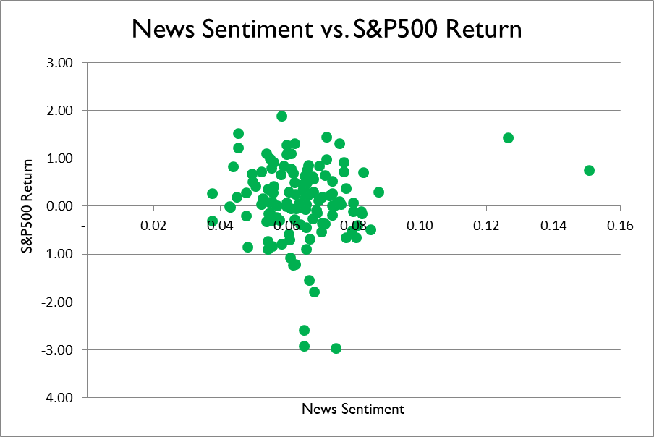
Let’s look at the other points

Slide 24
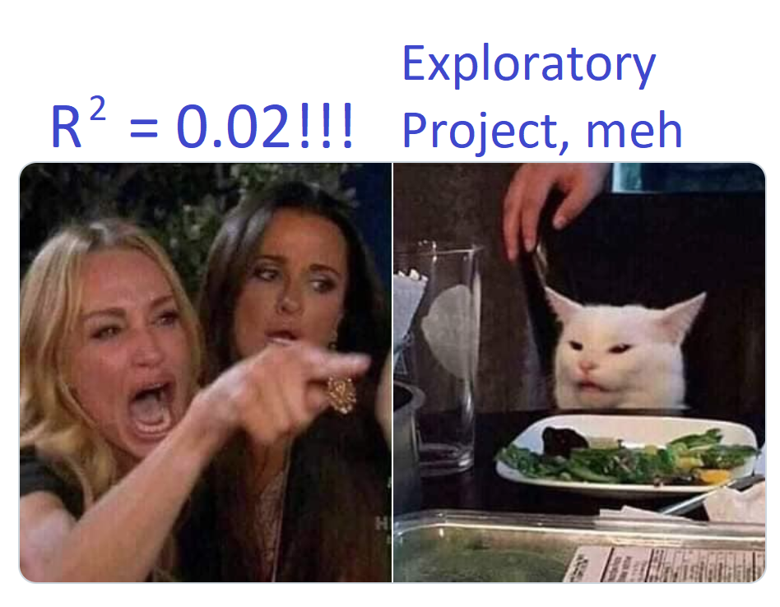

Slide 25
Sentiment Analysis - Finance
Evidence that news sentiment impacts stocks is weak. Monetizing is even harder
Possible reasons:
“NLTK” is not trained for financial news sentiment
Retail investors face many hurdles while trading
The financial markets are already very efficient
Stocks react to where reality materializes relative to prior expectations

Slide 26
Natural Language Processing
Advantage: many applications
Auto-complete / auto-correct
Customer satisfaction
Translation between two languages
Spam filters
Chat bots
Challenge: High quality NLP analysis requires a large amount of data, proper cleaning & pre-processing, and recurrent neural networks

Slide 27
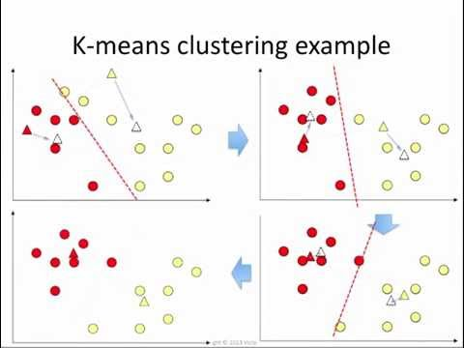
Appendix: K-Means Illustration

Slide 28
Appendix: K-Means Discussion
There were ~6,500 observations / news articles (n = 6,500)
I used the 250 most common words as my 250 features (m = 250)
Consideration 1: Choosing the number of clusters (value of k)
Consideration 2: Random initialization to avoid getting stuck at local optima

